Slide 1
ELEGANT ESTATE
Guide Name: Smt Anjitha P Arya S Roll No : 14

Slide 2
INTRODUCTION
Elevating real estate transactions.
Bridging buyers and sellers effortlessly.
Direct communication, transparency, and efficiency.
Where transactions are effortless and direct.
Redefining the real estate landscape.

Slide 3
PROBLEM STATEMENT
Inefficient intermediaries hinder direct communication in real estate; “ELEGANT ESTATE” simplifies transactions by connecting buyers and sellers directly."

Slide 4
EXISTING SYSTEM
More man power
Time consumption
Inefficient approach
Lack of accuracy
Prone to high level of human errors

Slide 5
PROPOSED SYSTEM
It increases efficiency.
Reduce manual effort.
It increases speed and accuracy.
Efficient service can be provided.
System will be very flexible

Slide 6
MODULES
The modules included in this project are:
Admin
Seller
Buyer
Visitor

Slide 7
SYSTEM SPECIFICATION
FRONT END
html
css
javascript
BACK END
Php
DATABASE
Mysql
TECHNOLOGY USED
bootstrap

Slide 8
HARDWARE SPECIFICATION
Processor : Dual-core
Hard disk : 50 GB
Memory : 1 GB
SOFTWARE SPECIFICATION
Front end : PHP
Back End : MySQL
Operating System : Windows
Web browsers : Any web browser

Slide 9
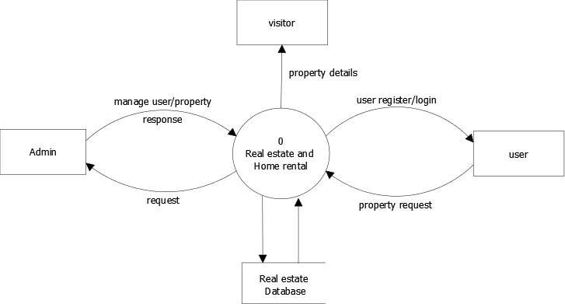
DATA FLOW DIAGRAM
Level - 0

Slide 10
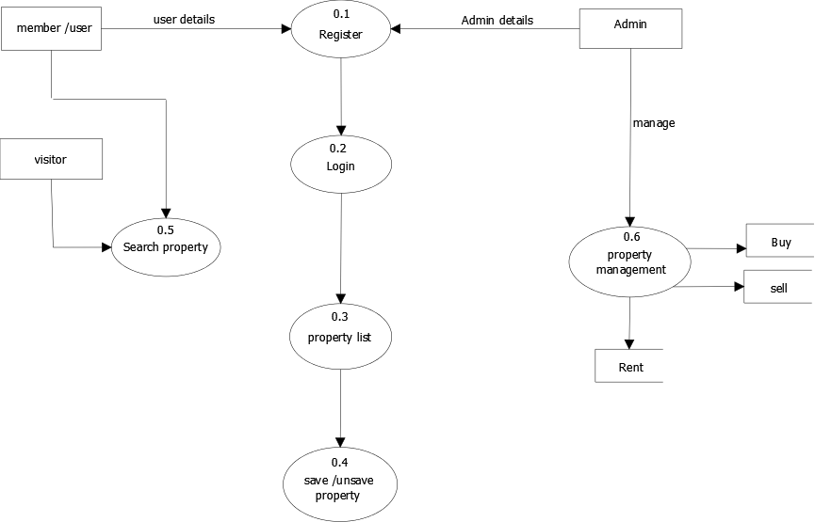
Level - 1

Slide 11
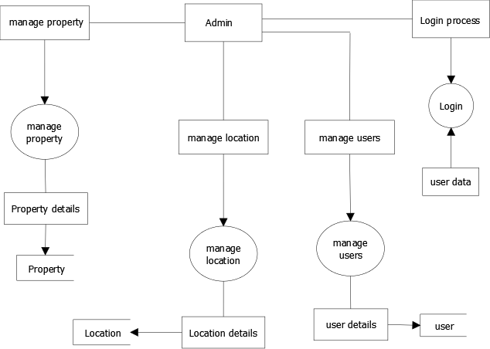
Level – 2 Admin

Slide 12
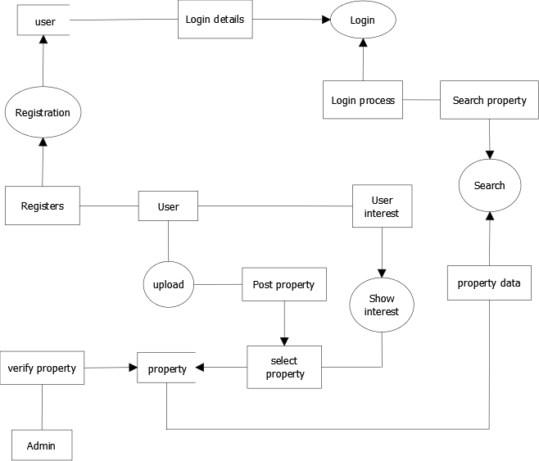
Level – 2 user

Slide 13
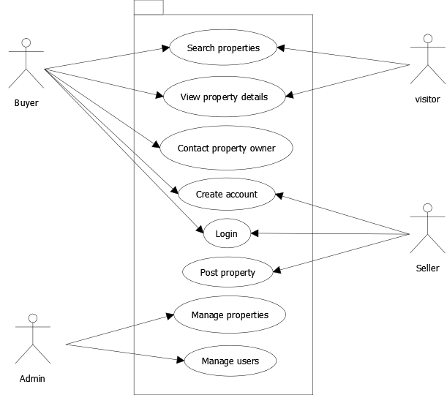
USE CASE DIAGRAM

Slide 14
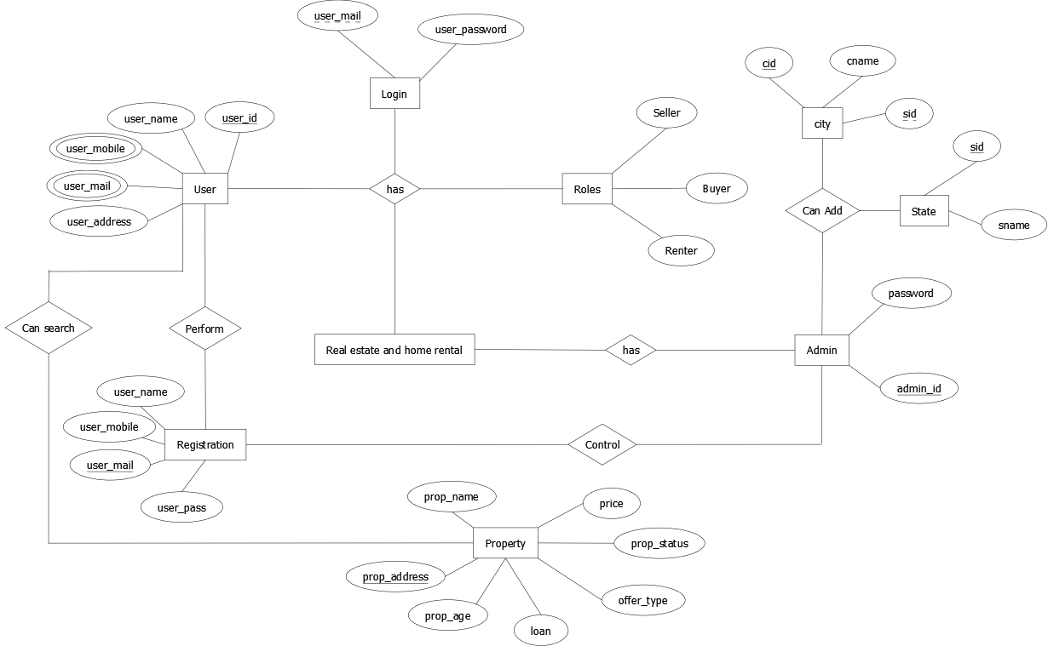
ER-DIAGRAM

Slide 15
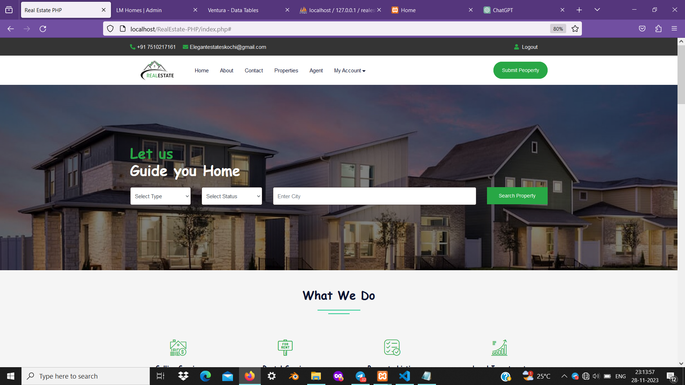
WORK DONE

Slide 16
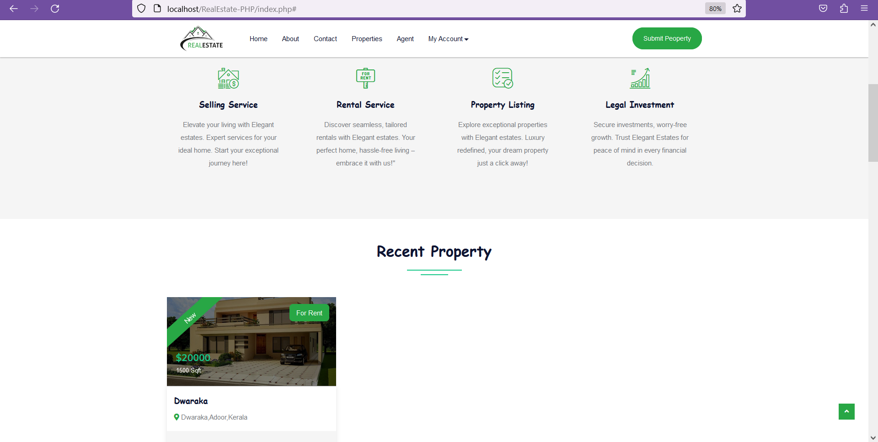

Slide 17
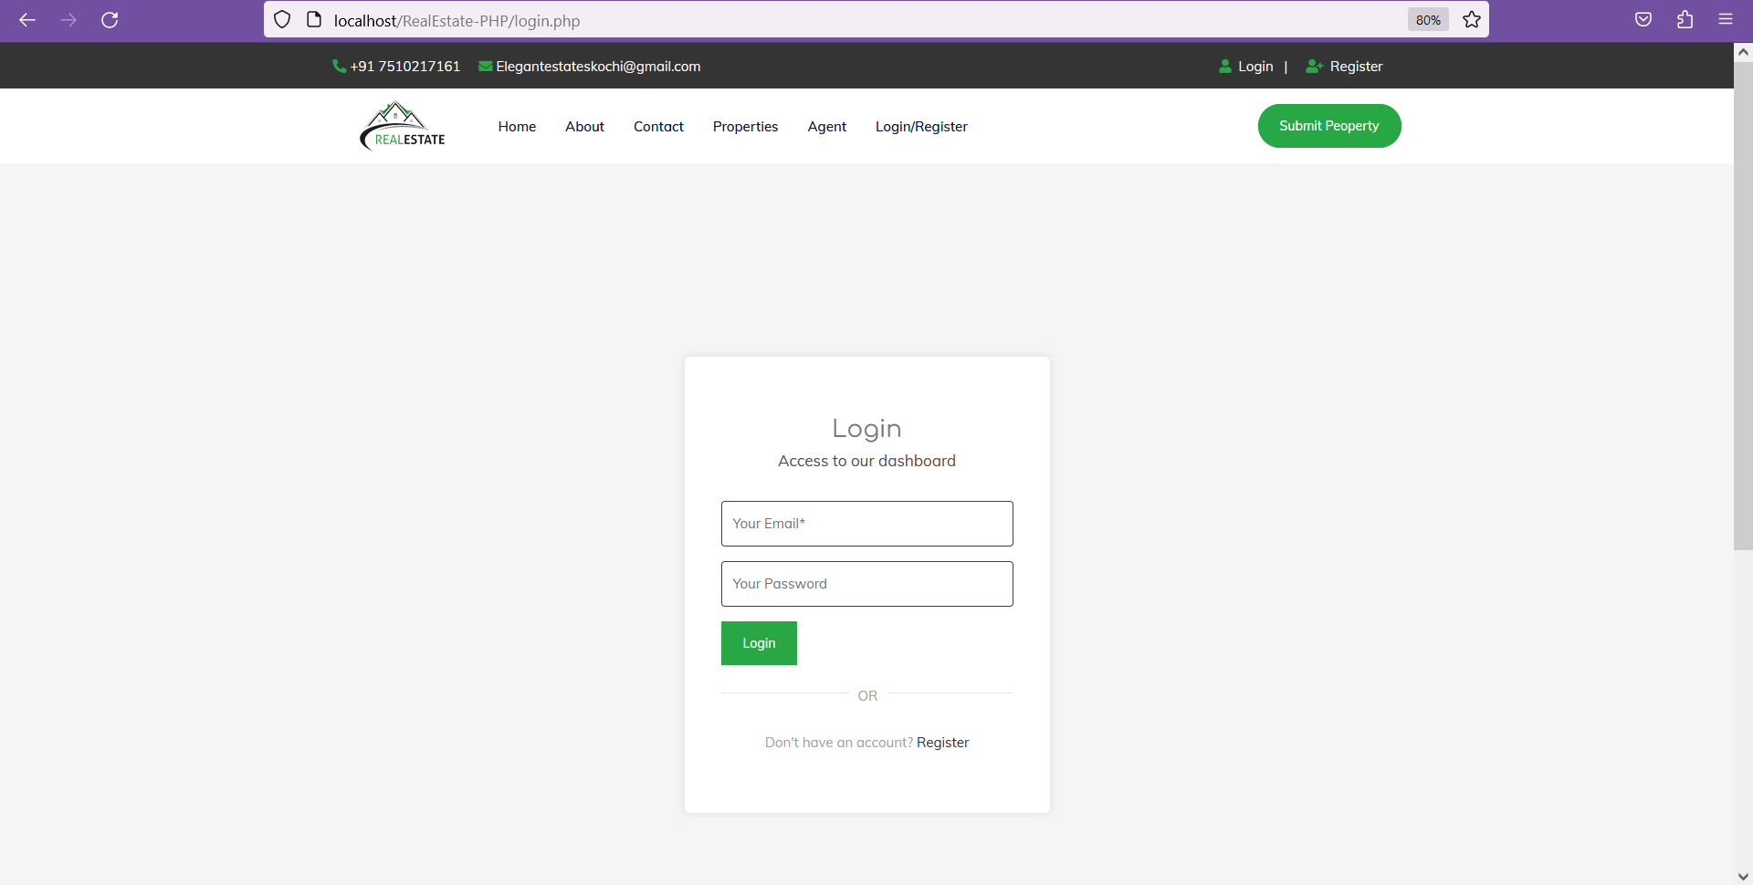

Slide 18
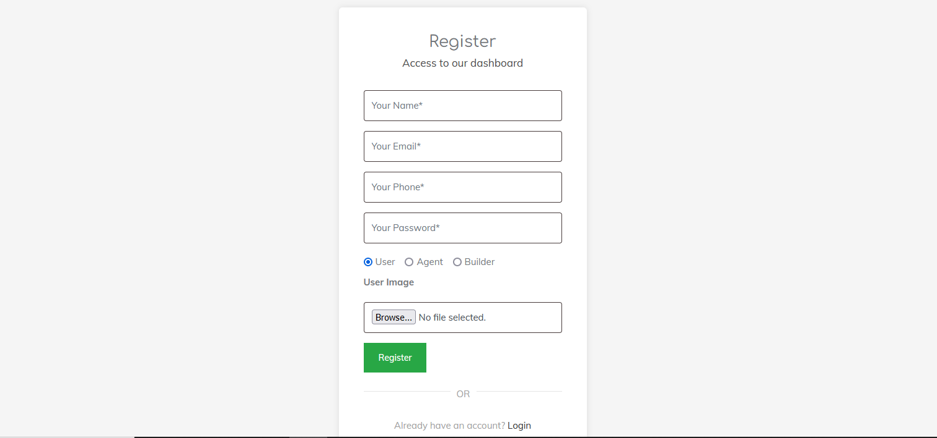

Slide 19
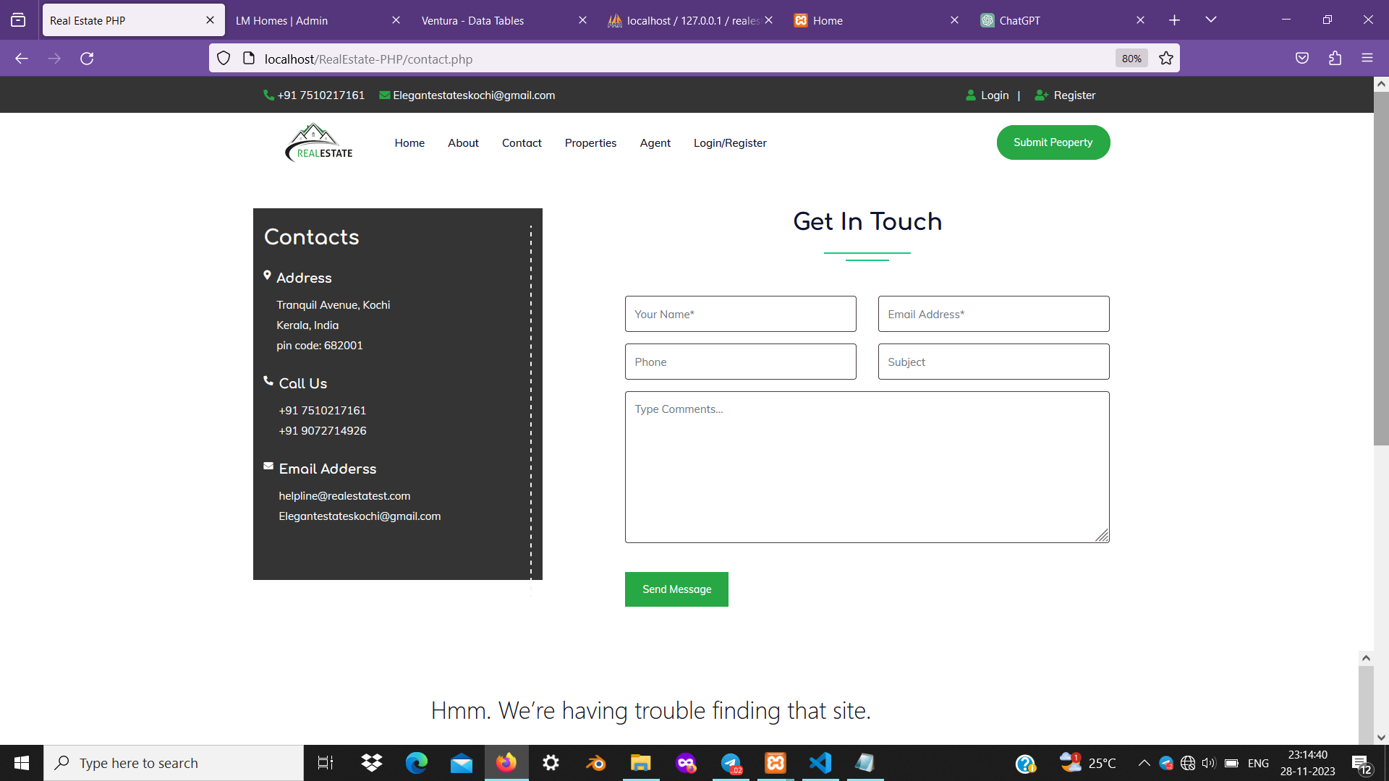

Slide 20
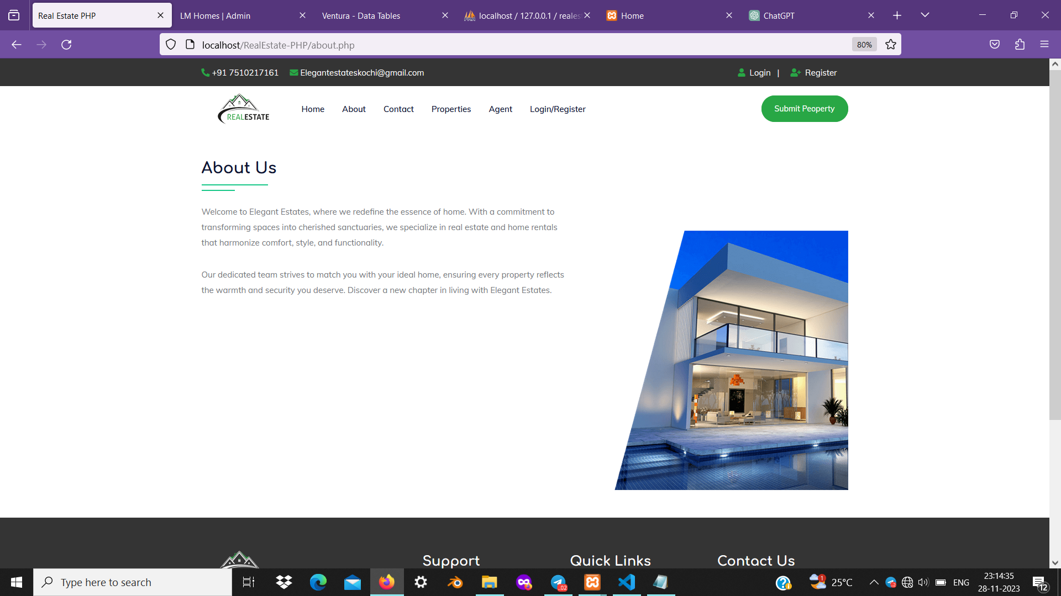

Slide 21
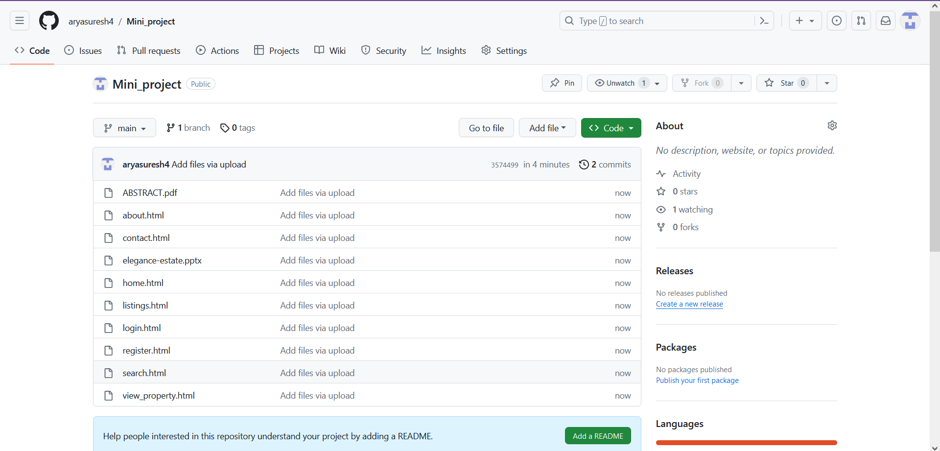
GITHUB HISTORY

Slide 22
CONCLUSION
The main purpose to develop this real estate management system project to resolve the issue of both buyer and seller.
The seller can submit the property what he wants to sale with a full house or flat detail such as location, area, hall, kitchen,furnished, semi-furnished, price, and all facilities can list in the form, Buyer can search the property according to their budget, location then direct contact to the seller.

Slide 23
REFERENCE
https://www.researchgate.net/publication/357528542_Real_Estate_Website
https://www.zillow.com/
https://github.com/topics/real-estate-management
Ambrose, P. and Barlow, J. (1987), Housing Provision and House Building in Western Europe: Increasing Expenditure, Declining Output, Housing Markets and Policies under Fiscal Austerity, London, Greenwood Press

